Slide 1
Used Cars Price Analysis
Web Scraping | Data Cleaning | EDA | Power BI Dashboard

Slide 2

Introduction
Growth of used car market in India
Online platforms enable multi-city listings
Need to analyze pricing trends and patterns
Project focuses on structured data analytics

Slide 3

Problem Statement
Car price variation based on various cars brands.
Best cars with good quality with less price.

Slide 4

Tools & Technologies Used
Python (Selenium & BeautifulSoup) for web_scrapping
Pandas for data handling
Power Query for cleaning
Power BI for visualization

Slide 5

Data Collection
City-wise scraping from CarDekho
Handled pagination across pages
Extracted brand, year, km, fuel, price, city
Stored data in CSV format

Slide 6

Data Cleaning
Appended city-wise datasets
Removed blanks and duplicates
Standardized text columns
Converted price to numeric INR
Created price & km range columns

Slide 7
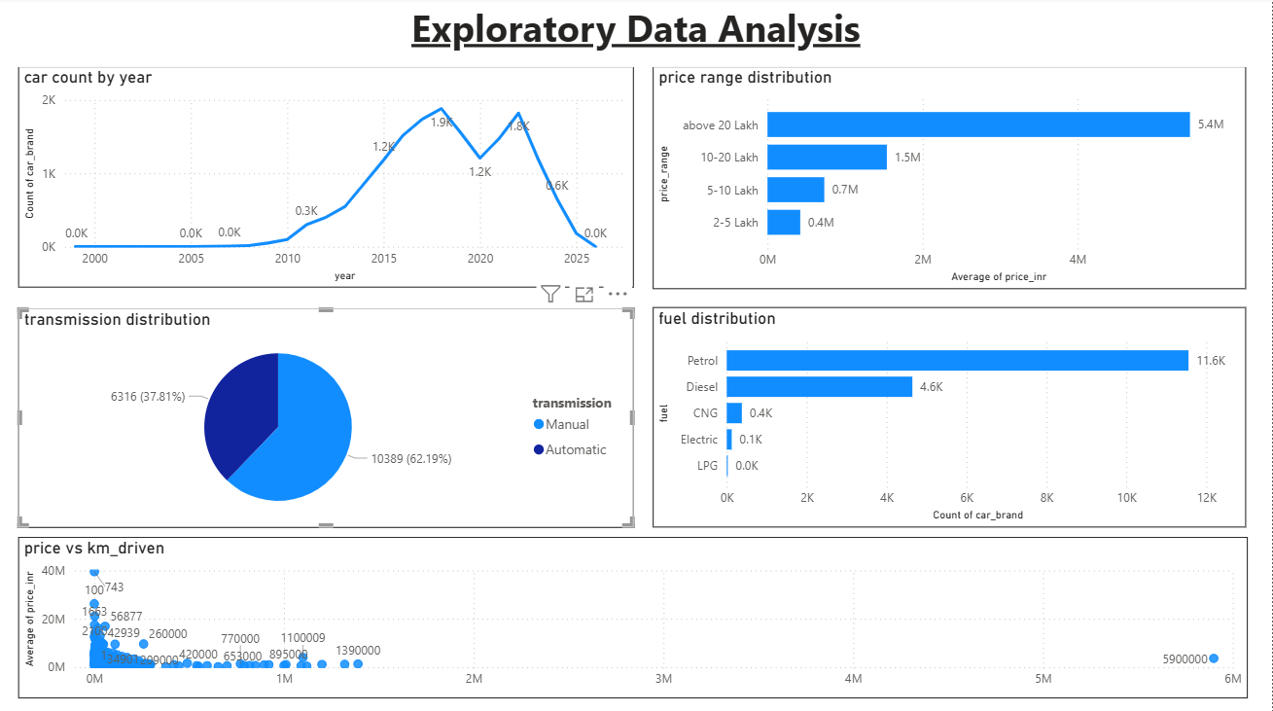
Exploratory Data Analysis
Car count by year
Price range distribution
Fuel distribution
Transmission distribution
Price vs km_driven

Slide 8
Dashboard Structure
Page 1 – Market Overview
Page 2 – Price & Brand Analysis
Page 3 – Best Value Analysis
Interactive slicers for filtering

Slide 9
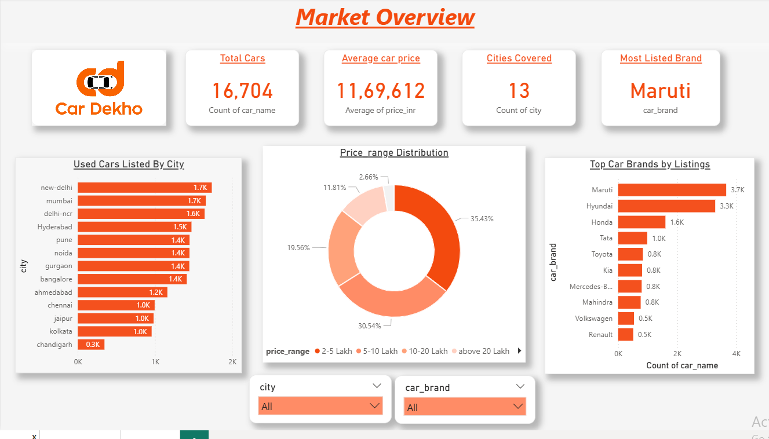
Market Overview
Maruti is the most listed brand
Majority of cars are mid-range priced
Hyderabad and major metro cities have high listings
Affordable segment dominates the market

Slide 10
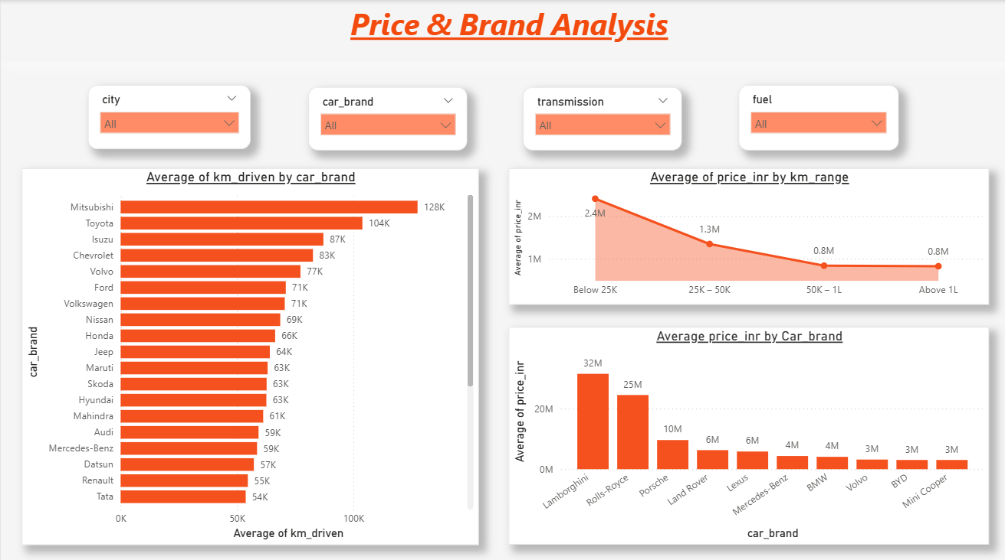
Price and Brand Analysis
Luxury brands have highest average prices
Electric vehicles show higher average pricing
Newer vehicles command premium prices

Slide 11
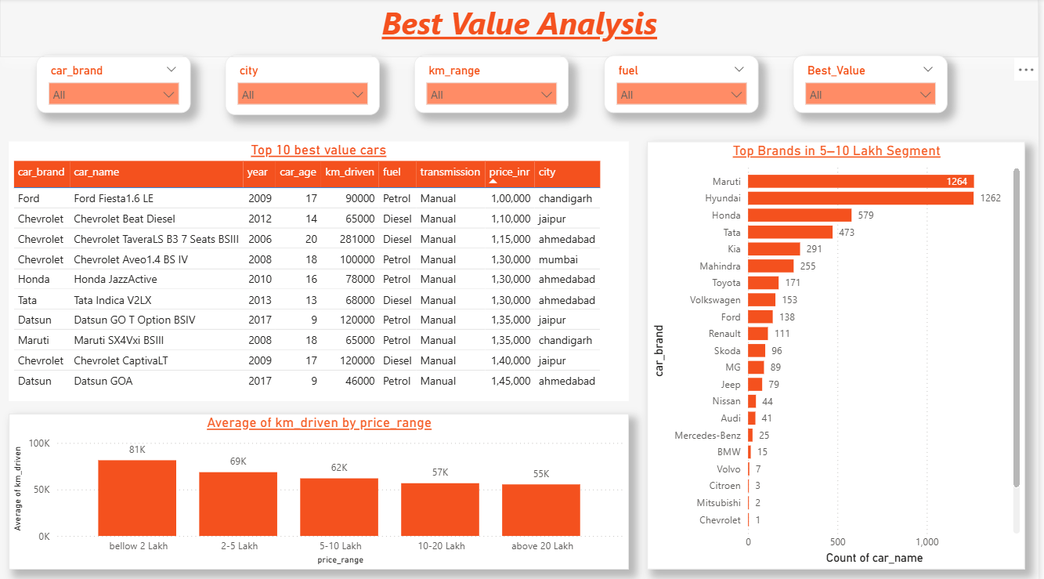
Best Value Analysis
Top brands in 5-10 lakhs segment
Average km_driven by price_range
Top 10 best value cars

Slide 12

Key Insights
Brand plays a major role in price variation in the used car market.
Luxury brands dominate high-price segments, while Maruti and Hyundai dominate mid-budget segments.
Most used cars fall in the ₹2–10 Lakh range.
Petrol vehicles are more common than Diesel and Electric in resale market.
Manual transmission vehicles are more frequently listed.
Cars with lower kilometers driven have significantly higher resale prices.
The best value cars (low price + moderate usage) are mostly from:
Maruti
Hyundai
Honda
Tata
Ford
The ₹5–10 Lakh segment has the highest number of listings, making it the most competitive segment

Slide 13

Challenges Faced
Dynamic web scraping
Managing multi-page pagination
Cleaning price formats (Lakh/Crore)
Handling large multi-city dataset

Slide 14

Conclusion
End-to-end analytics workflow implemented
Provided multi-city pricing insights
Built interactive dashboard in Power BI
Demonstrated practical data analytics skills

Slide 15

Future Scope
Add more cities for deeper insights
Implement predictive price modeling
Compare multiple car platforms
Integrate EMI & financing analysis

Slide 16


